Slide 1
Colonial
PIPELINE RANSOMWARE
ATTACK

Slide 2
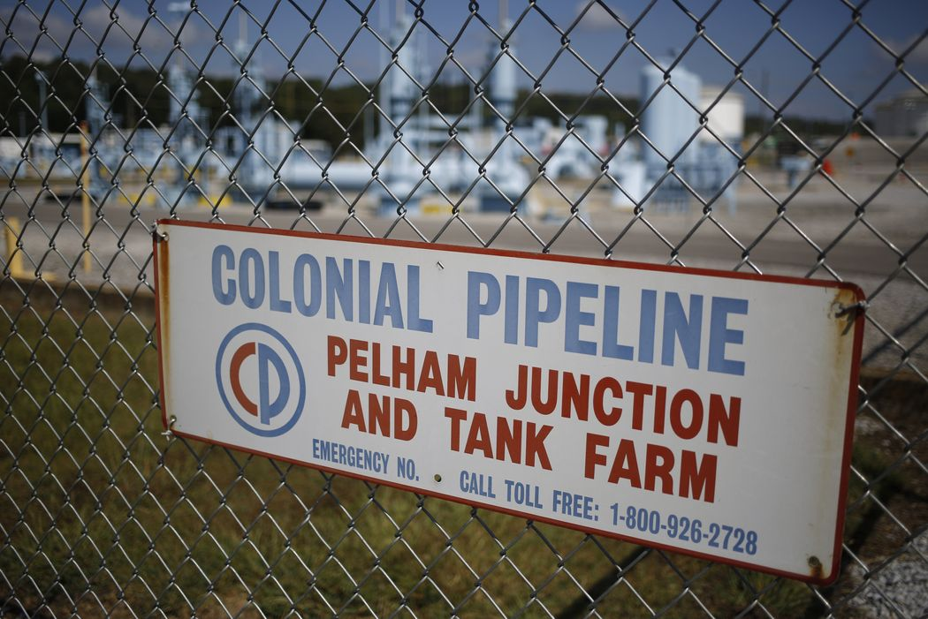
TABLE OF CONTENT
INTRODUCTION
WHAT HAPPENED?
THE AFTERMATH
THE IMPACT
PREVENTION AND PREPAREDNESS
CONCLUSION

Slide 3
INTRODUCTION
Welcome to our presentation discussing the Colonial Pipeline Ransomware attack, a significant cyber incident that underscored the vulnerabilities in critical infrastructure. In May 2021, Colonial Pipeline, a major US fuel pipeline operator, fell victim to a devastating ransomware attack. This attack caused widespread panic and fuel shortages across the East Coast.
The attack was executed by a cybercriminal group known as DarkSide, who demanded a $4.4 million ransom in exchange for the decryption key needed to regain control of Colonial Pipeline's systems. This incident not only highlighted the escalating threat posed by cyber attacks but also raised critical questions regarding the security of vital infrastructure and the necessity for enhanced preparedness in confronting such threats.

Slide 4
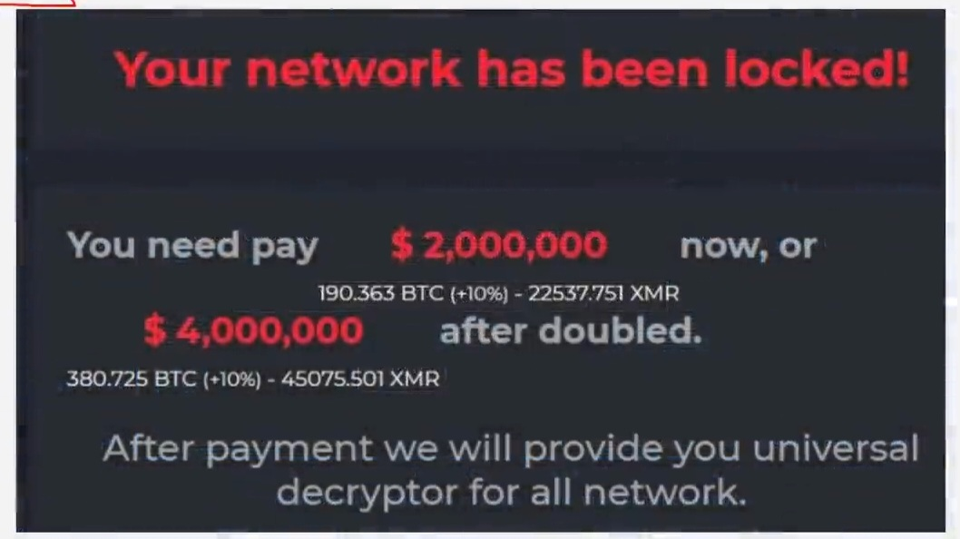
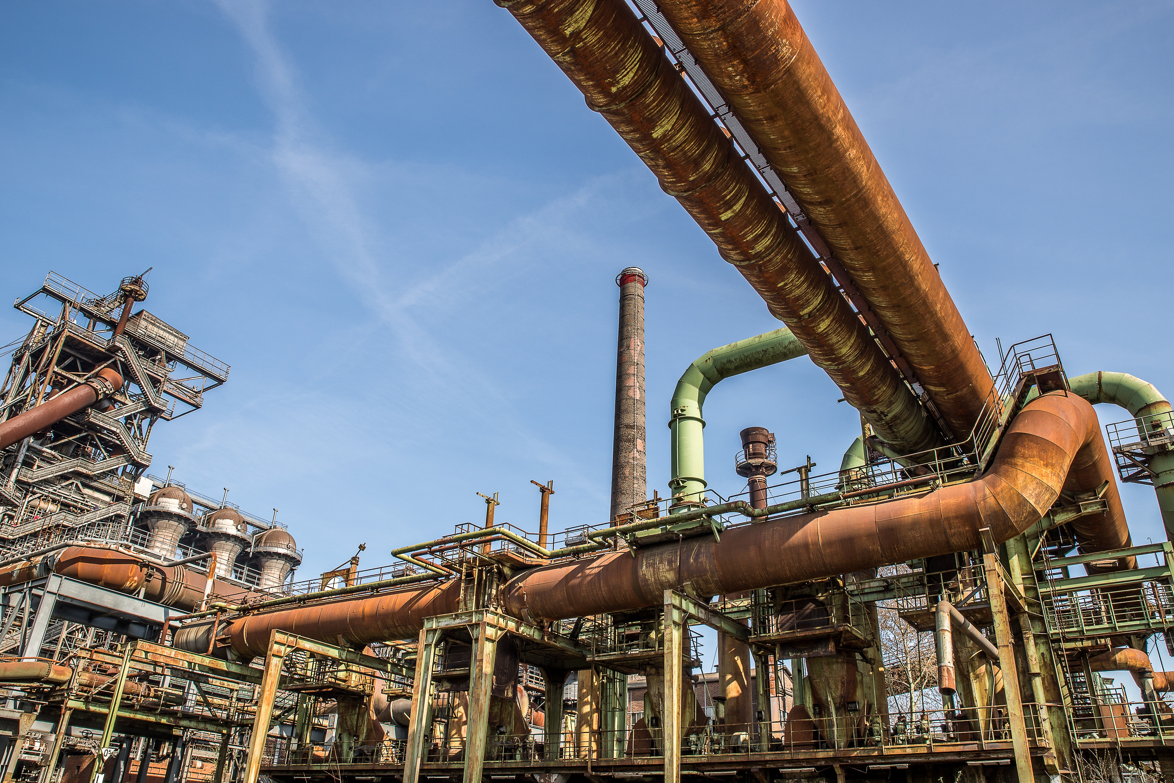
HINT: To change this single image.
1- Right Click on top of the image.
2- Choose “Change Picture” 3- Choose option “From a File” 4- Locate your file and open
WHAT HAPPENED
( IN COLONIAL PIPELINE )
On May 7th, 2021, Colonial Pipeline, a prominent US fuel pipeline operator, fell victim to a ransomware attack conducted by a group known as Darkside. These attackers managed to breach Colonial's computer systems and encrypt their data, demanding a ransom payment in exchange for the decryption key.
This cyber assault had widespread consequences, forcing Colonial Pipeline to suspend its operations for several days. This disruption resulted in fuel shortages and increased prices across the East Coast. This incident shed light on the vulnerability of critical infrastructure to cyberattacks and emphasized the imperative for enhanced security measures to safeguard such vital systems.

Slide 5
After the ransomware attack on Colonial Pipeline:
THE
AFTERMATH
Supply Disruption: The attack disrupted fuel supplies along the East Coast, causing panic buying and fuel shortages.
Operational Shutdown: Colonial Pipeline responded by shutting down its operations to address the issue and restore its systems to normal functioning.
Criticism and Evaluation: The company faced criticism for its handling of the incident, with experts suggesting potential improvements in prevention and response.
Emphasis on Preparedness: The incident underscored the importance of preparedness and robust cybersecurity measures to protect against such attacks.
Industry-Wide Response: As a result, organizations across various sectors have taken proactive steps to enhance their cybersecurity posture and readiness for future cyber incidents.

Slide 6
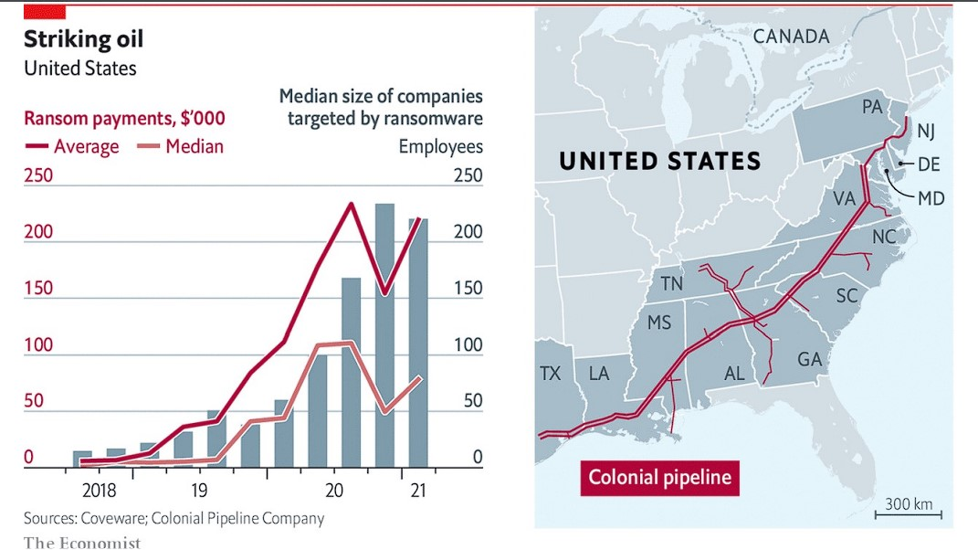
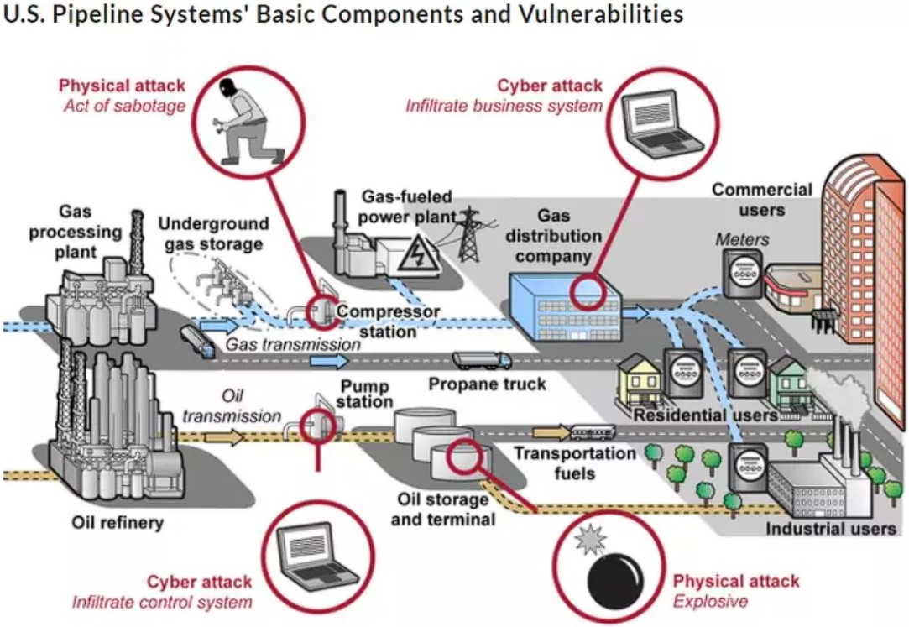
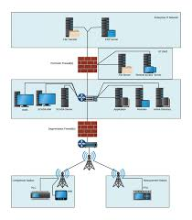
THE IMPACT
Economic Impact
Infrastructure Vulnerabilities
Cybersecurity Preparedness
The attack disrupted the energy sector, causing fuel shortages and price increases, which had a ripple effect on the national economy.
It exposed vulnerabilities in critical infrastructure that could be exploited by cybercriminals or nation-state actors..
The incident raised concerns about the ability of companies and governments to respond effectively to cyber threats. To protect systems and data in our technology-dependent world, it's crucial to invest in cybersecurity measures, develop robust response plans, and conduct regular training and drills.

Slide 7
Prevention And Preparedness
In Colonial Pipeline Ransomware Attack

Slide 8
Prevention (Companies)
HINT: To change any of these single images.
1- Right Click on top of the image.
2- Choose “Change Picture” 3- Choose option “From a File” 4- Locate your file and open
NOTE: To change this image with your own, along with the other images in this template follow these steps. 1. click on the image and hit delete.
2. Then click the icon in the middle of the box. 3. find your image and insert the image.
1 Invest in Robust Security Measures
PREVENTING CYBER ATTACKS
Companies should allocate resources to deploy strong security tools like firewalls, antivirus software, and intrusion detection systems.
2 Regular Security Audits
Conduct routine security audits to proactively identify vulnerabilities and mitigate them before potential exploitation.

Slide 9
4 Response Planning
Preparedness entails the development of detailed response plans to effectively address cyber attacks when they occur.
5 Incident Response Teams
PREPAREDNESS
Organizations should establish specialized teams trained to handle cyber incidents promptly and efficiently.
6 Communication Protocols
Clear communication protocols are vital to ensure seamless coordination during a cyber incident.
7 Training and Drills
Regular training sessions and simulated drills are essential to hone the ability to respond swiftly and systematically to cyber threats.

Slide 10
CONCLUSION
Wake-Up Call: The Colonial Pipeline ransomware attack served as a stark reminder of the profound repercussions cyber attacks can inflict on critical infrastructure and society as a whole.
Preventive Action: To avert future incidents, proactive measures are imperative. This includes substantial investments in cybersecurity measures, constant vigilance against evolving threats, and preparedness for effective response in case of attacks.
In summary, the Colonial Pipeline incident underscores the urgency of safeguarding critical infrastructure from cyber threats through robust cybersecurity practices and readiness, reinforcing the need for comprehensive preventive actions in our digital era.

Slide 11

ACKNOWLEDGEMENT
Project Team
PRANEET NOYAL HARISH
(2302570049)
(2302570023)
(2302570053)
(Group leader &
Creative Director)
(Speaker & Presenter)
(Speaker & Presenter)
Special Thanks To : RAJAT SIR

